Slide 1

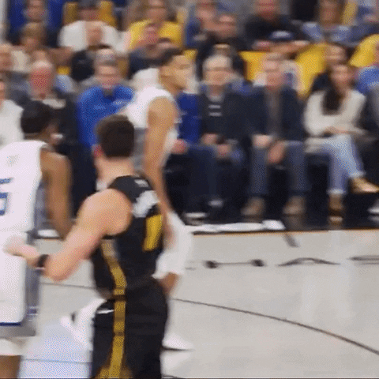
Did Stephen Curry Change the NBA?
Broghan O’Connor

Slide 2
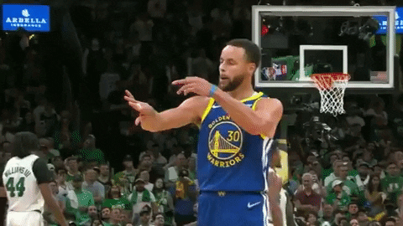
Who Curry is
Curry is a three-point specialist point guard on the Golden State Warriors that has won 4 NBA championships since 2015.
The Warriors hold the best regular season record at 73-9 in 2016.

Slide 3
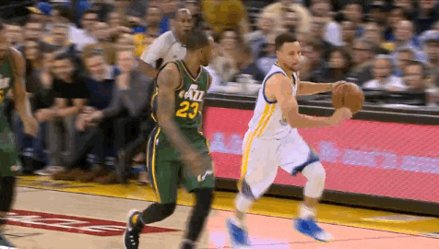
How
The Warriors played a new brand of basketball that focused on a fast-paced game, shooting threes, ball movement, and solid defense.
Despite being undersized, Curry has dominated the NBA by his shooting, passing, and leadership ability.
Decided to look at
3 pt rate
Points
Assists
General trends

Slide 4
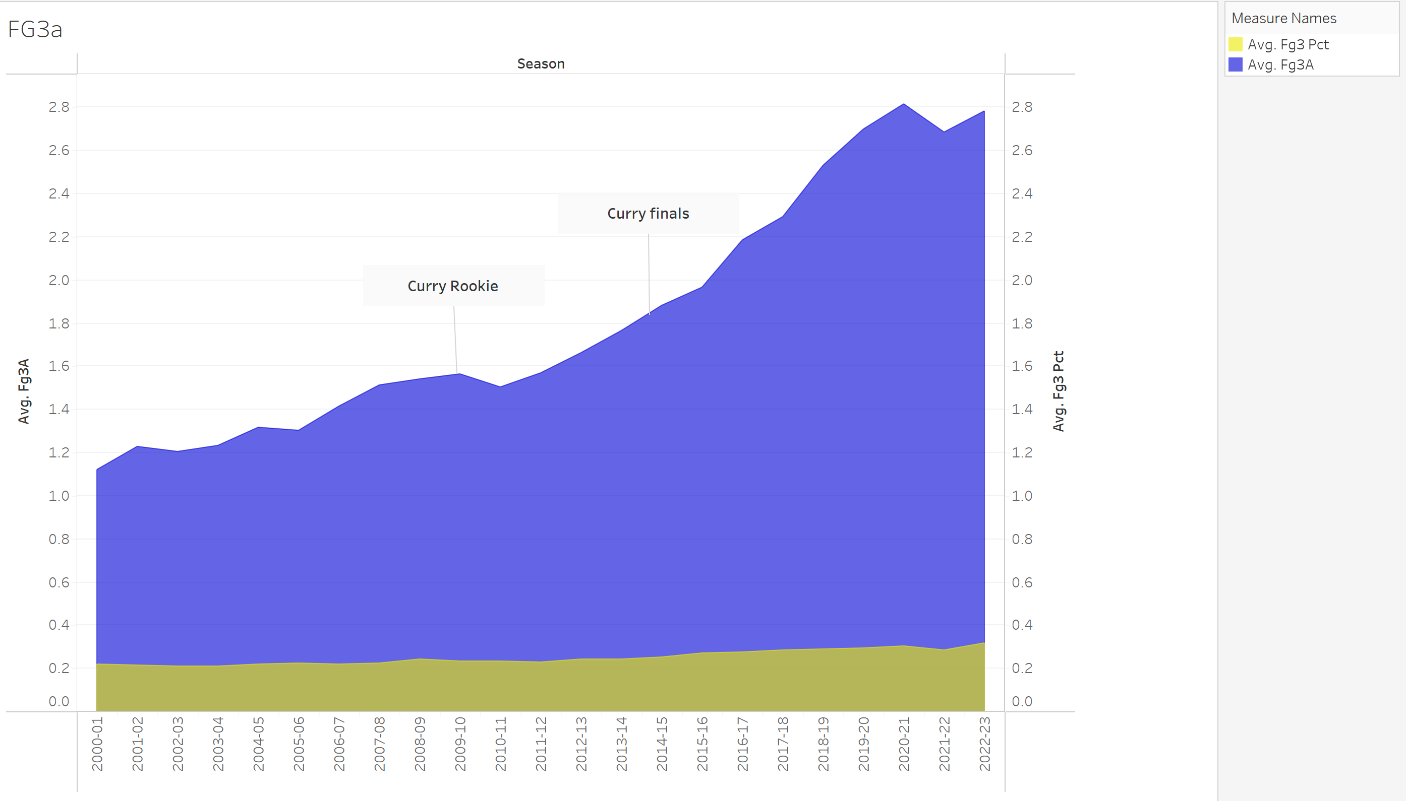
3 pt shots attempted / 3pt %

Slide 5
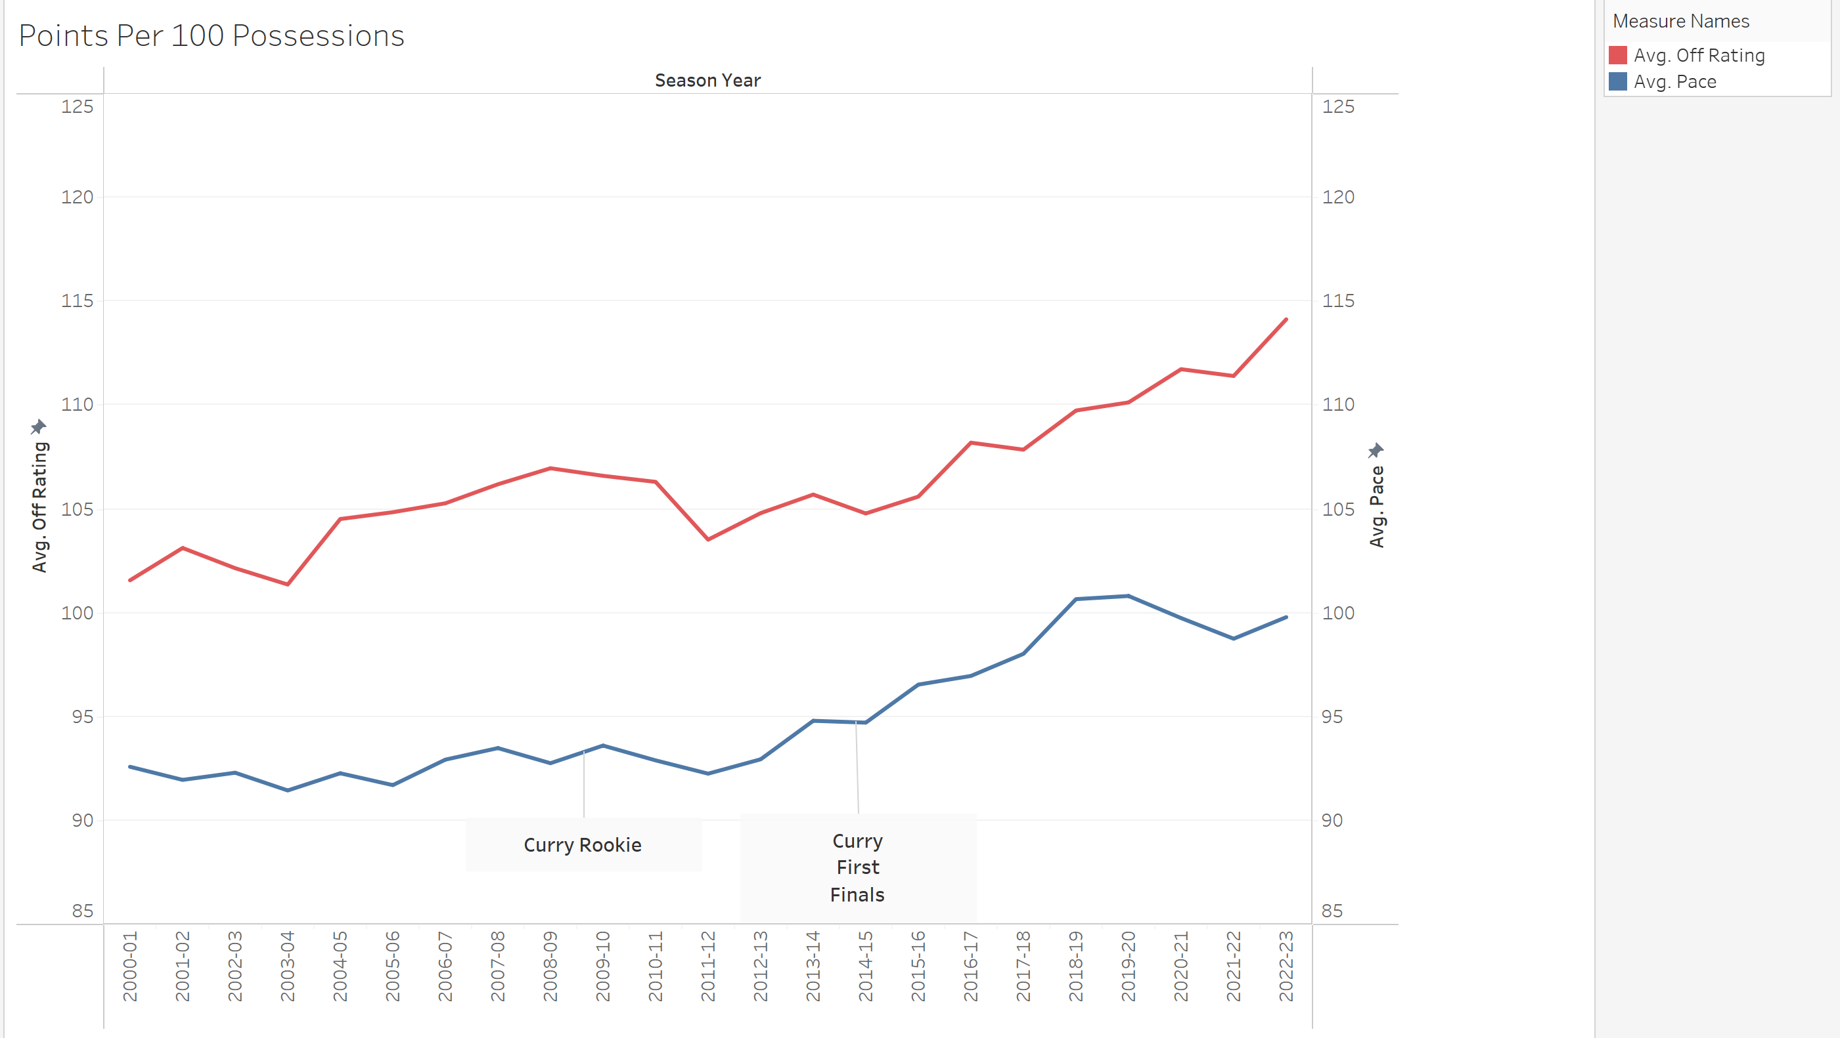
Points / pacing

Slide 6
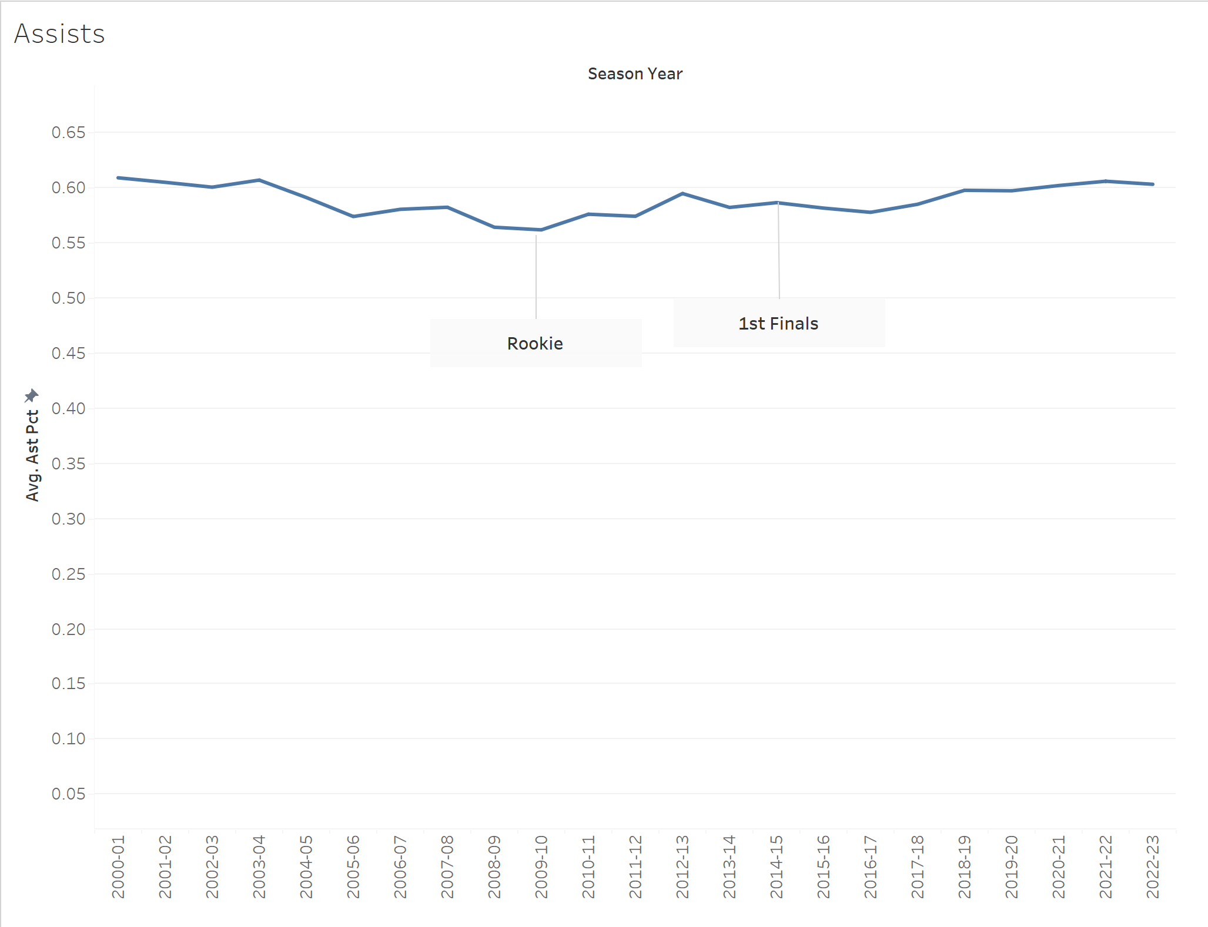
Assists

Slide 7
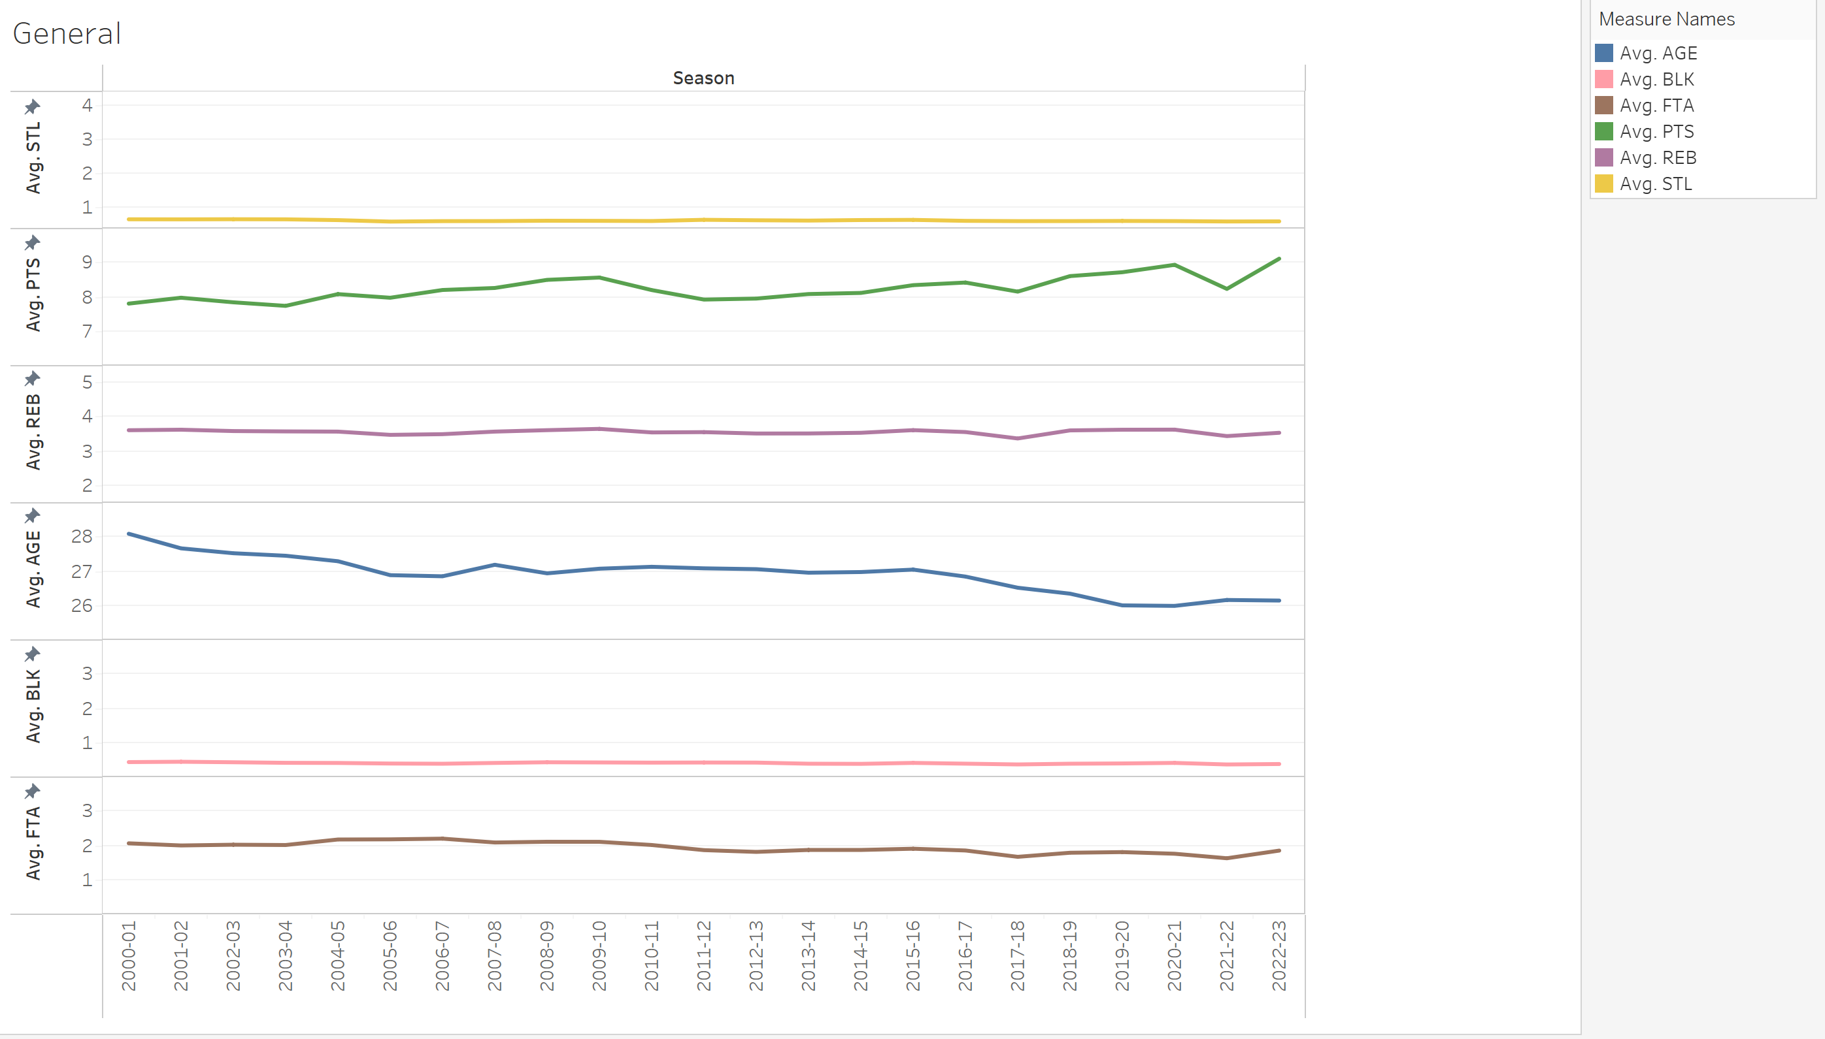
General Trends

Slide 8
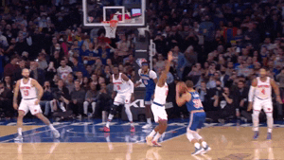
Conclusion
Curry and the Warriors affected
3 pt shot trends
Pts per game
Pacing trend

